Slide 1
Chemical Properties

Slide 2

By the end of this lesson, you should be able to:
Explain what a chemical property is.
Identify examples of chemical properties.

Slide 3
Unlike physical properties, chemical properties are only observable during or after a chemical reaction.
Thus, we can use a reaction to figure out the chemical properties of the substances involved.
In the same way, we can use a substance's chemical properties to predict how it will react with another substance.

Slide 4
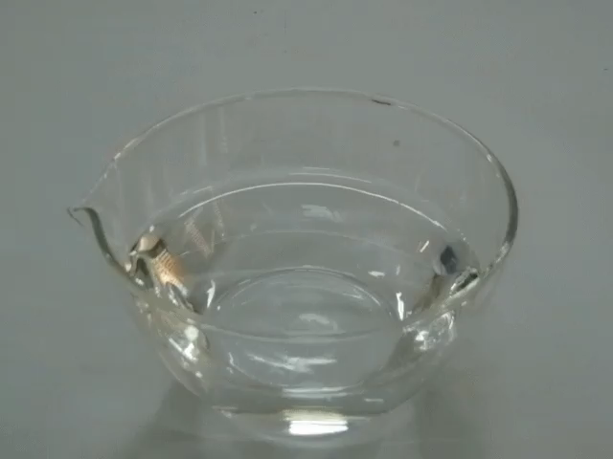
Reactivity is the ability of a substance to react.
Some substances are more likely to react than others.
For example, magnesium and sodium are very reactive metals - they even react with water! Metals like gold and silver, however, are much less reactive.

Slide 5
Corrodibility is a metal's ability to corrode.
In general, corrosion is the reaction of metals with the air to form different chemicals. This leaves coloured coatings or wears the metal away.
Iron is very corrodible because the presence of water and air will turn it into rust.
The Statue of Liberty is copper, but the surface has corroded, developing a green coating.

Slide 6
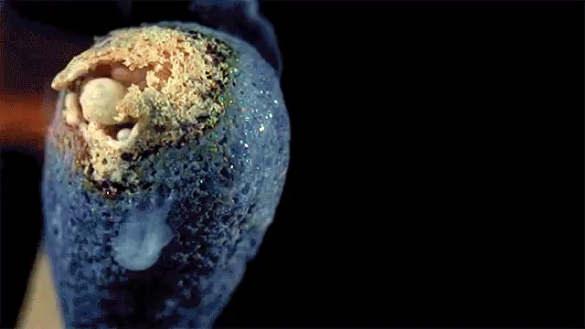
Flammability is a substance's ability to catch on fire.
Fire is a reaction with oxygen, so really flammability is how likely a substance is to react with oxygen.
Carbon-based substances (like wood, paper and oil) are very flammable, while substances like water and iron are not.

Slide 7
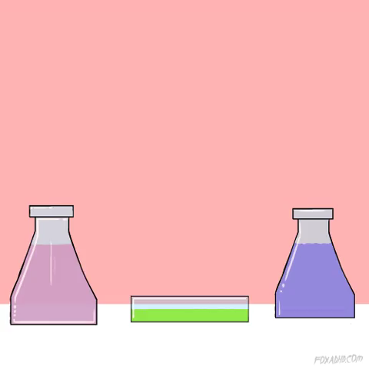
Toxicity is a substance's ability to be poisonous.
Many substances you will deal with in chemistry are toxic in some way. Many solutions are only toxic if swallowed, but chemicals like mercury can be dangerous upon contact with the skin too.
Always practice safe chemistry and try to avoid contact with toxic chemicals.

Slide 8

Light sensitive chemicals react when exposed to light.
Some chemicals are very unstable: with just a small amount of energy, they can react to form a new chemical.
Light can often provide that energy. Chemicals which change when exposed to light are light sensitive.
Methane and bromine react, but only when exposed to sunlight - this reaction is light sensitive.

Slide 9
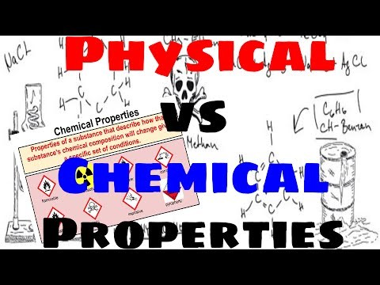

Slide 10
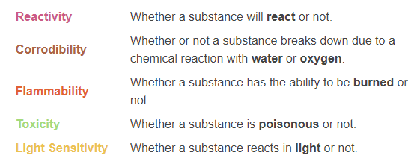
Chemical properties summary:

